Slide 1
Smart Compose for Medical Applications
Data-X Project by:
Fred Hertlein, Sophie Pealat, David Scanlan, Olivia Zhang
Partnership with:
Abboud Chaballout - Diagnoss

Slide 2

Context
Medical Visit
Report
Medical Coding
Insurance
Notes:
examination report is translated to codes sent to insurance companies who determine the amount of money they have to send to doctors, etc…

Slide 3
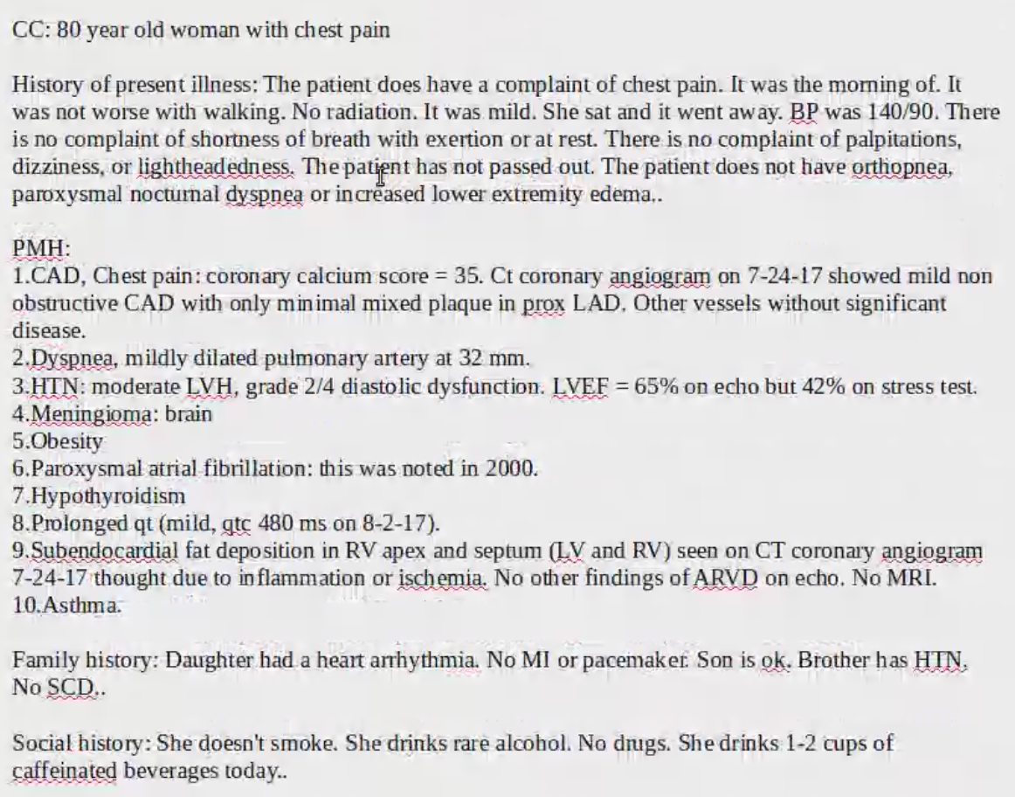
Example Medical Report
Example Medical Codes Shown To The Right:
CC = Complications
PMH = Past Medical History
CAD = Coronary Artery Disease
HTN = Hypertension / High Blood Pressure
LVH = Left Ventricular Hypertrophy
SCH = Subchronic Haematoma
Notes:
NABC!!!!
The overall structure =a summary of complications, a detailed description and history of present illness, past medical history, family history, social history

Slide 4
Context
30% medical coding errors
$210B lost or delayed revenue
Notes:
However, today 30% of medical coding are errors, that corresponds to $210B lost or delayed revenue for doctors, clinicians, hospitals

Slide 5
Impact:
“Doctors spending twice as much time filling out paperwork as visiting with patients”
Develop better technologies to automate the paperwork process + reduce medical coding errors
Save time for doctors and optimize hospitals’ efficiency in the current Covid-19 situation
J-Marc Overhage, Annals of Internal Medicine
Notes:
Doctors spend > 16 minutes w/ electronic health record per encounter
twice times more amount of time spent on documentation than on patient examination
Doctors spending twice as much time filling out paperwork as visiting with patients.
Talk about Covid19 implications : saving time for doctors

Slide 6
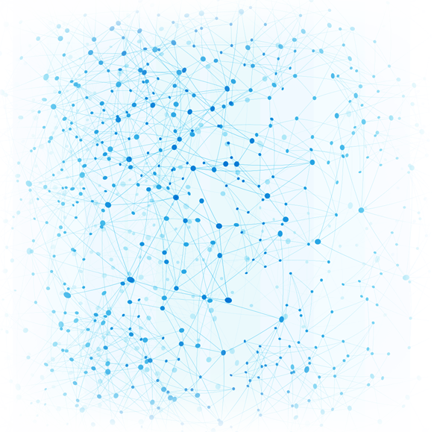

About Diagnoss:
Company is using ML to drive a predictive healthcare analytics engine
Assigns medical coding +
Acts as a “medical version of Grammarly”
The first application of Diagnoss is to use AI to reduce errors in medical coding
Notes:
shares the same goal with Diagnoss in terms of reducing the tremendous amount of time doctors spend on doing paperwork as well as reducing medical coding errors,
we focus on the the autocompletion. our project can be seen as a complement to what Diagnoss is doing

Slide 7
Our Project:
Build a model that autocompletes doctors’ input of examination reports for insurance billing purposes
Notes:
This is old. From low tech demo, concept of how it works. Needs to be prompted / slow. Our goal is a more fluid solution.

Slide 8
Approach
Collecting Data
Cleaning Data
Train Model on Medical Data
Selection of Model
Building UI
Searching for Models
Train Model on Example Text Data

Slide 9
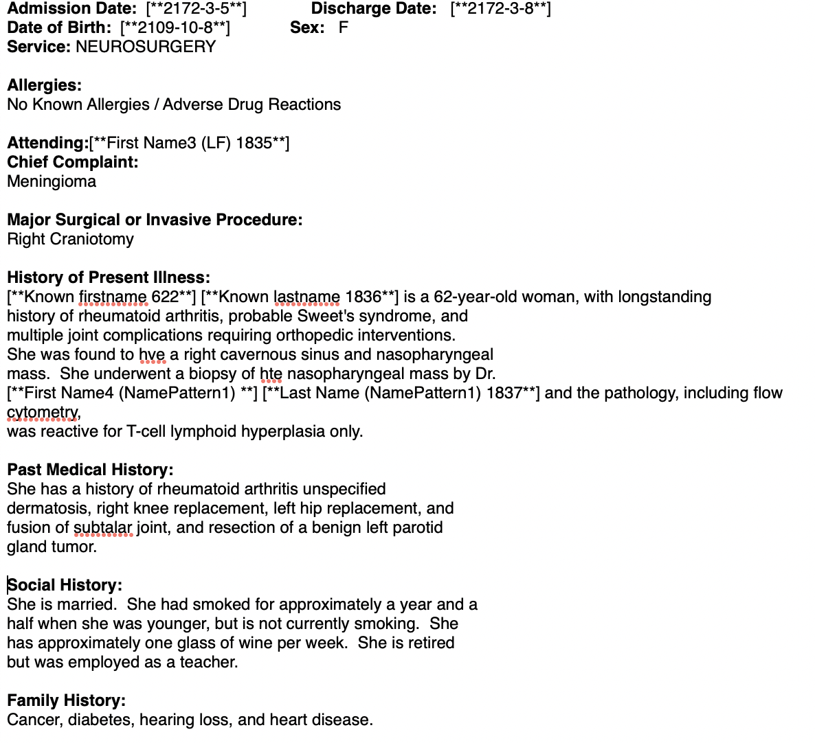
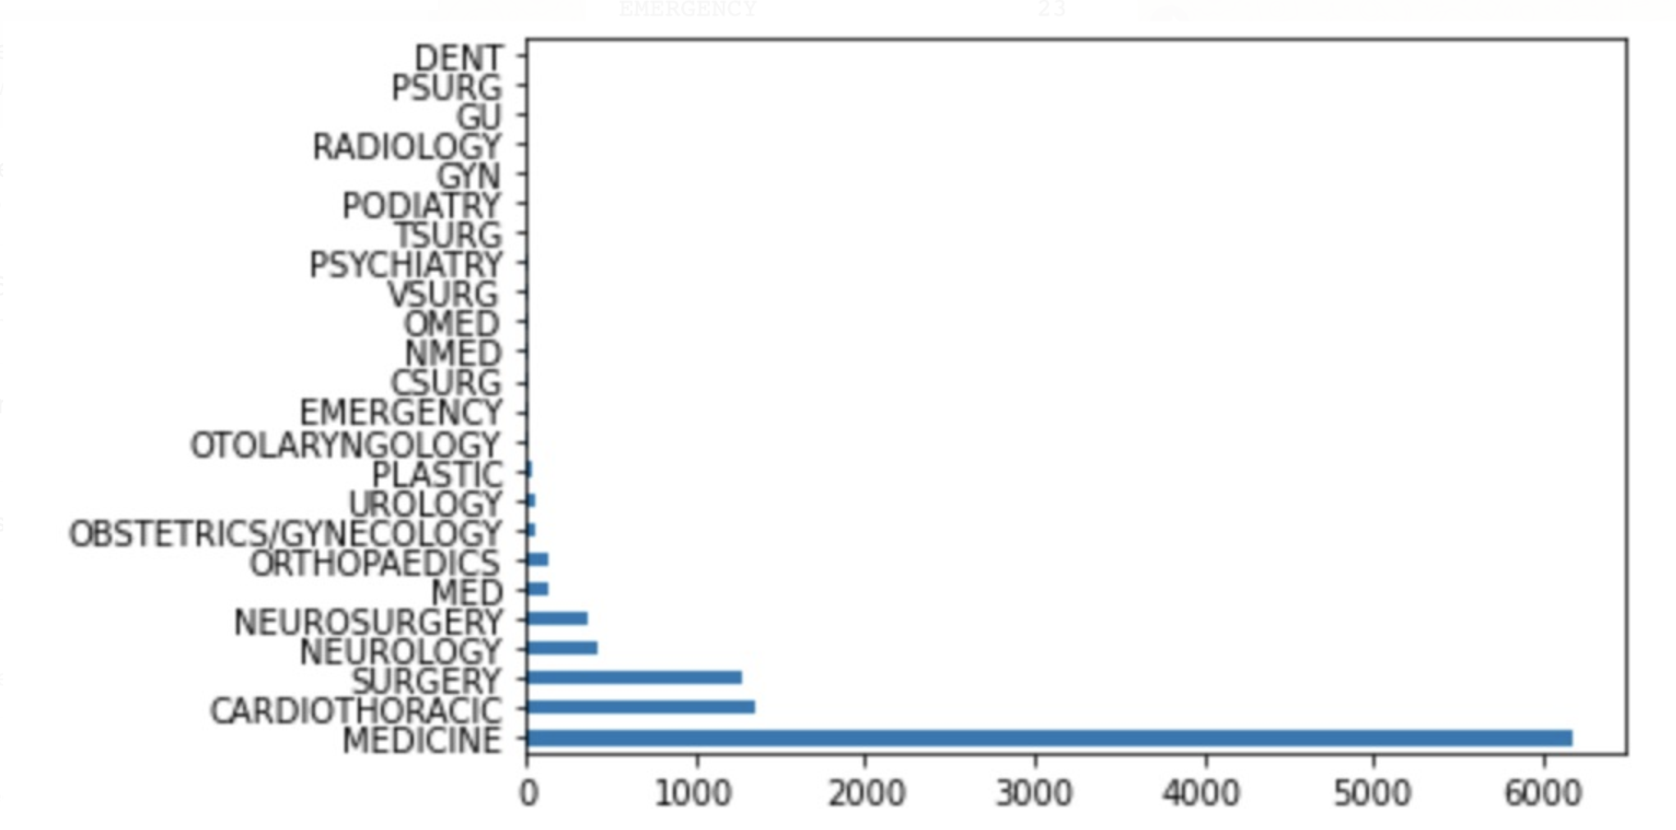
Data Processing
Access to MIT Database : 2 million medical reports
MIMIC-III Clinical Database
Selection of Categories:
Medicine
Cardiothoracic
Surgery
Neurology/Neurosurgery
* Based on 20,000 row training set
Notes:
Example of the beginning of a medical report: as you can see, many different sections. We had to select which sections we were more interested in and also sections that contain text to train our model (useless to work with the admission date)
Mention difficulty getting access to data. Had to pass medical / privacy questionnaire, and follow up weekly with administrator to get access.
Inconsistency in data. Not every row was identical. Had to standardize proprocessing process.

Slide 10
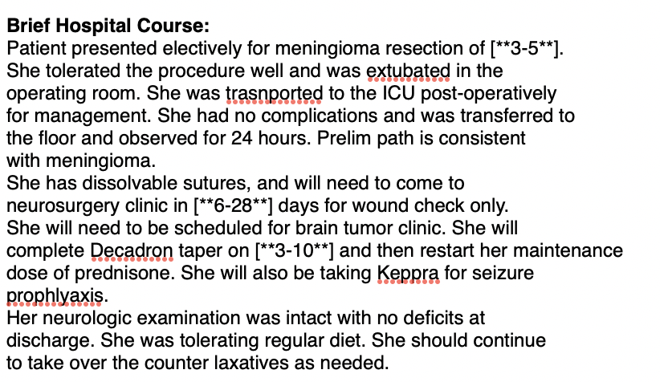
Data Processing cont.
Notes:
Selection of brief hospital course section : made more sense because we learn about the journey of the patient in the hospital (useful for the medical coding system because the billing is calculated regarding what has been done at the hospital).
Brief Hospital Course provides an overview of the pateint end-to-end at the hopsital

Slide 11
Model Information: GPT-2
Developed by Open.ai
Open source model used to generate coherent paragraphs of text
Trained on 40GB of Internet text
Part of Transformers libraries
Our goal : Use transfer learning to train this model on a medical dataset
Notes:
learning transfer
complex neural network
Include discussion about learning path : what have been tried, didn’t work/ work

Slide 12
Model Performance: GPT-2
Models trained from scratch on medical report dataset :
GPU
Large memory
Long time (1h - 5h)
Main Parameters :
Block Size : 50
Number of training epochs : 1 or 2
Save steps : 1000 or 3000
Number of batch eval size : 1
Models | Perplexity
Model Medicine | 14.57
Model Cardiothoracic | 19.50
Model Surgery | 26.48
Model Neurology | 24.12
Model “Raw data” (7000 complete reports) | 5.8
Notes:
Used a GPU on Colab Pro, needed a large Ram so we created a Colab pro account to get a larger memory. However, we couldn’t train models containing more than 20000 reports ( tried with 1M, 500k, 100k, 50k and it was too large). Also had to adapt the parameters to decrease the memory used.
Explain meaning each parameter : more important : block size (Optional input sequence length after tokenization. The training dataset will be truncated in block of this size for training.)
Talk about time for training depends on the parameters chosen, for instance : number of epochs increases, the running time increases. Size block size increases, running time increases : example with 256 for block size and 3 epochs, could take more than 7hours.
Checkpoints saved every 1000 or 3000 iterations took a lot of storage space, had to decrease the number of checkpoints.
When we train the model on more data, the perplexity decreases: entropy (=uncertainty) decreases. Add explanation about perplexity

Slide 13
Examples of predictions : prompt “The patient felt”
Parameters for prediction
Temperature : 0.7
Length : 10
Top_K = 50
Prompt
Number of return predictions
Time : 8s-12s
Models | Examples of Predictions
Model Medicine | The patient felt well after extubation. He was started
Model Cardiothoracic | The patient felt more stable from a cardiac standpoint. He was
Model Surgery | The patient felt that she had been left with a low grade of
Model Neurology | The patient felt that she had been given a good dose of PR
Model “Raw data” (7000 complete reports) | The patient felt well until she had a respiratory arrest
Notes:
Talk about the differences in the predictions: using different models, our outputs are different (take into account he categories). For instance, prediction from cardiothoracic model is related to cardiac disease whereas prediction with surgery model is related to surgery.
Temperature important parameter : Float value controlling randomness in boltzmann
distribution. Lower temperature results in less random completions. As the
temperature approaches zero, the model will become deterministic and
repetitive. Higher temperature results in more random completions. is a hyper-parameter used to control the randomness of predictions by scaling the logits before applying softmax. when temperature is a small value (e.g. 0,2), the GPT-2 model is more confident but also more conservative. when temperature is a large value (e.g. 1), the GPT-2 model produces more diversity and also more mistakes
2 different ways of sampling :
-Top_K : the K most likely next words are filtered and the probability mass is redistributed among only those K next words.
-top-p : Top-p sampling chooses from the smallest possible set of words whose cumulative probability exceeds the probability p.

Slide 14
System Architecture:
Client Side
Server Side
Client Input
Previous History
Web App Interface
Procedure Template
Backend
Server
(Flask)
Databases
Dynamic Hooks
(React)
Data
(MI)
Report Message
User Interface
(Material-UI)
Models
(GPT2)
Model Weights
(TensorHub)

Slide 15
UI Demo:
Github Repository: https://github.com/gfhertlein/medical_smart_compose

Slide 16
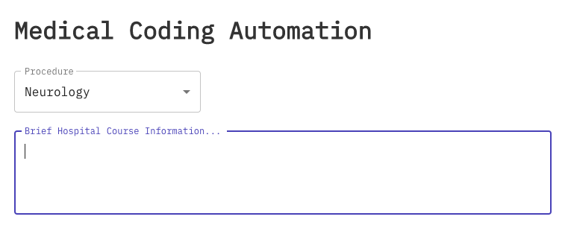
UI Demo:

Slide 17
Limitations and Further work
1 - Char Ngram Models via GPT2 Transfer Learning
2 - Faster Server or Static Model Predictions
3 - UI Simplicity + Formatting
4 - Training model on Diagnoss Data
Notes:
Main aspect that has to be improved : the speed of the prediction

Slide 18
Thank You !
Q&A

Slide 19
Github Repository
https://github.com/gfhertlein/medical_smart_compose

